Slide 1
(5) Energy and ecosystems
5.1 Food chains and food webs

Slide 2
Learning objectives:
How does energy enter an ecosystem?
How is energy transferred between the organisms in the ecosystem?
What is meant by the terms: ‘trophic level’, ‘food chain’, ‘food web’, ‘producer’, ‘consumer’ and ‘decomposer’?
Specification reference: 3.4.5

Slide 3
Success Criteria
I can correctly define the following key terms: Producer, Consumer, Decomposer, Detritivore, Food chain, Trophic level, Food web, Herbivore, Carnivore, Omnivore, Heterotroph, Autotroph.
I can draw and label food chains.
I can draw and label food webs.
I can answer exam questions on food chains and webs.

Slide 4
Starter Activity: In pairs can you define the following key terms? You have 5 minutes!
Producer
Consumer
Decomposer
Detritivore
Food chain
Trophic level
Food web
Herbivore
Carnivore
Omnivore

Slide 5
Producer
Is an autotroph (organisms that can produce organic molecules from simple inorganic molecules with the aid of an additional energy source).
Producers are more specifically photoautotrophs, organisms that depend on photosynthesis i.e. manufacture substances using light energy, water and carbon dioxide.
6CO₂ + 6H₂O + light energy → C₆H₁₂O₆ + 6O₂
Carbon dioxide + water + light energy → glucose + oxygen
All green plants are producers.

Slide 6
Consumer
Is a heterotroph – an organism that gains its nutrients from complex organic molecules. These are broken down into simple soluble molecules by digestive enzymes and then built up again to form the organic molecules which the organism requires. Heterotrophs ultimately depend on autotrophs.
Simply consumers are organisms that obtain their energy by feeding on (consuming) other organisms rather than using the energy of sunlight directly.
All animals are consumers. Those that directly eat producers are primary consumers. Those eating primary consumers are called secondary consumers. Those eating secondary consumers are called tertiary consumers. Secondary and tertiary consumers are usually predators but they may also be scavengers or parasites.

Slide 7
Decomposer
A microorganism (bacteria and fungi) that breaks down the organic compounds in dead material and waste products into carbon dioxide, water and simple inorganic ions. Decomposition releases valuable minerals and elements in a form that can be absorbed by plants and so contribute to recycling.

Slide 8
Detritivore
An animal which feeds on pieces of partly broken down plant or animal tissue known as detritus. Many soil organisms such as earthworms and woodlice are detritivores. Together with decomposers, they play an important part in the cycling of soil nutrients. Detritivores break up tissue exposing a much greater surface area to attack and break down by decomposers. This increases the rate of decomposition.

Slide 9
Food chains
A sequence which represents the way in which energy is transferred from one organism to another in a community. An example of a food chain would be:
Nettle plant → large nettle aphid → two-spot ladybird → blue tit → sparrow hawk.
Each stage in a food chain is referred to as a trophic level. The arrows in a food chain represent the direction of energy flow. Energy is lost at each stage by processes such as respiration. This means it is rare for any food chain to have more than five links.
Question: Can you label the five trophic levels in the food chain above?

Slide 10
Activity: Complete the table below to give 3 examples of food chains.
Trophic level | Grassland | Pond | Seashore
Quaternary consumer | Stoat | Pike | Seagull
Tertiary consumer | Grass snake | Stickleback | Crab
Secondary Consumer | Toad | Leech | Whelk
Primary consumer | Caterpillar | Water snail | Limpet
Producer | Grass | Pondweed | Seaweed
Toad, stoat, caterpillar, crab, leech, grass snake, pond weed, pike, seagull, stickle back, whelk, water snail, limpet, sea weed, grass
The first one has been done for you!

Slide 11
Food webs
A diagram which shows the way in which all the different species of organism in a community depend on each other for food. A food web is made up of many interconnected food chains.
Food webs can be very complex as it is likely that all organisms within a habitat, even an ecosystem, will be linked to others in the food web. Charting the feeding inter-relationships of thousands of species is not feasible. Relationships are not fixed but change depending upon the time of year, age and population size of the organisms.

Slide 12
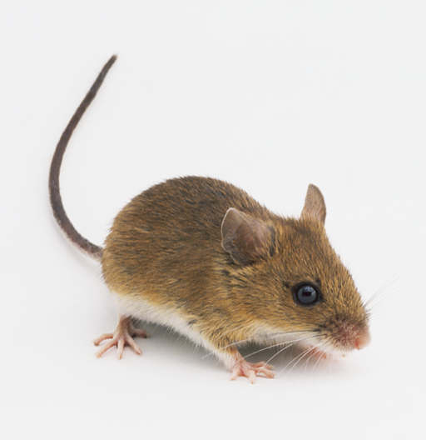
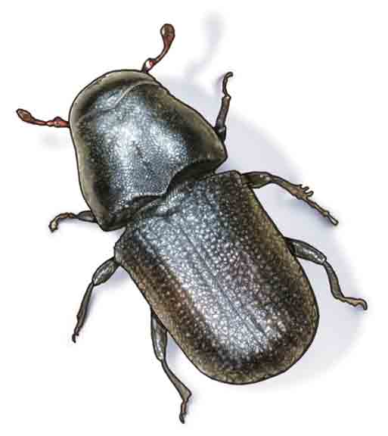
Food chains can be linked to form food webs

Slide 13
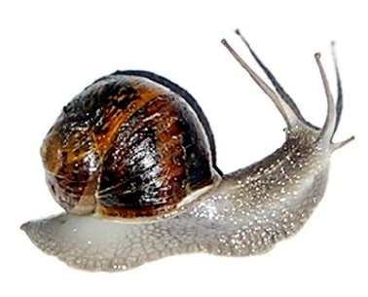
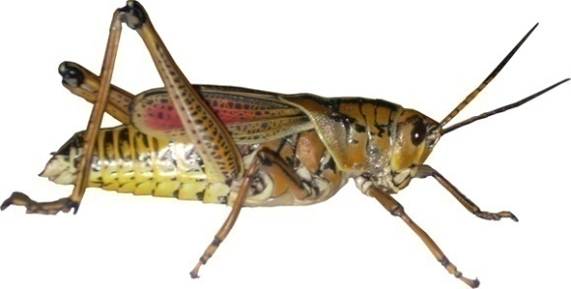
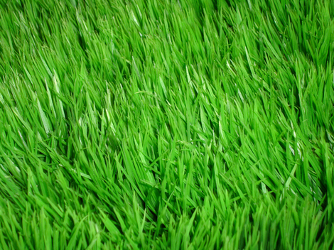
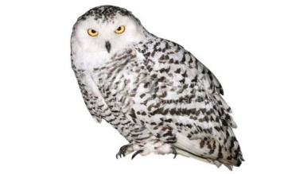
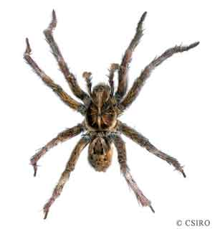
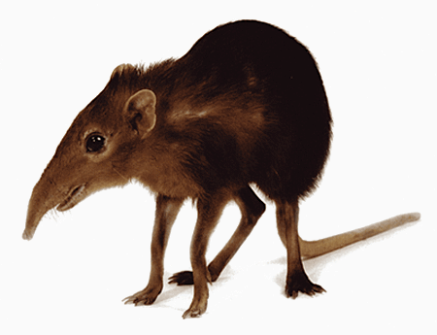
Add these organisms to your food web.
Snail
Grasshopper
Wood mouse
Grass
Beetle
Owl
Shrew
Spider

Slide 14
Food chains can be linked to form food webs

Slide 15
You have 5 minutes to make as many different food chains as you can from your food web?
Grass → Grasshopper → Spider → Shrew → Owl
Grass → Grasshopper → Spider → Wood mouse → Owl
Grass → Snail → Wood mouse → Owl
Grass → Snail → Shrew → Owl
Grass → Beetle → Spider → Shrew → Owl
Grass → Beetle → Spider → Wood mouse → Owl
Grass → Beetle → Owl

Slide 16
Plenary Activity
Complete the exam question.
You are marked out of 5

